Slide 1
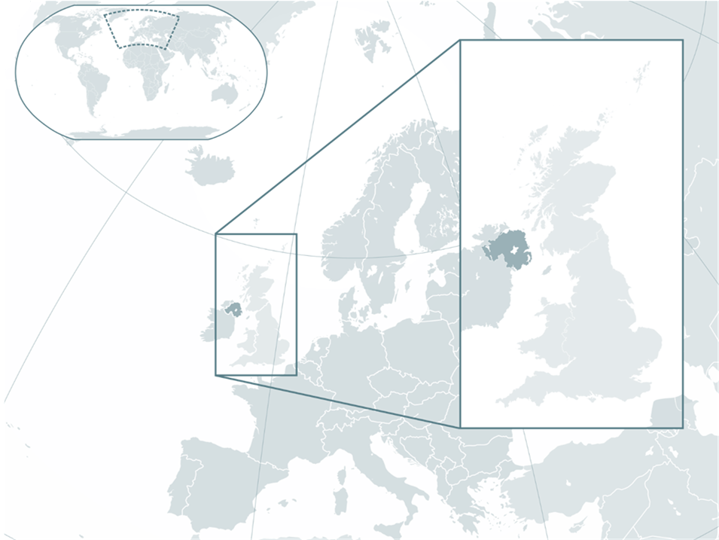
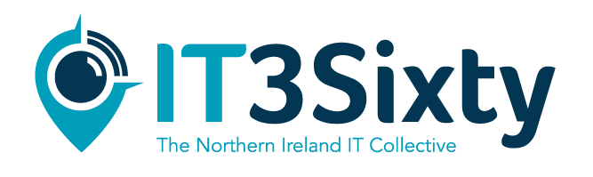

Slide 2
Overview
About Northern Ireland
Living and Working here
Careers in IT
Current Opportunities
Getting here
Register your interest

Slide 3
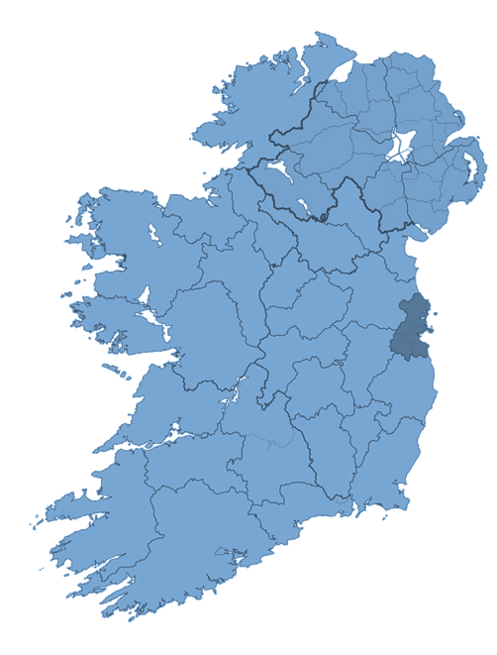
About Northern Ireland
Northern Ireland is the happiest place to live in the UK (ONS).
Northern Ireland has a population of 1.8 million people and is one of the youngest in Europe, with 55% of the population under the age of 40.
In 2012 Northern Ireland was voted one of the world's top destinations (National Geographic Traveller, 2012)
It is the safest region in the UK (British Crime Survey, 2011)

Slide 4


Slide 5
About Northern Ireland
Belfast is the capital city of Northern Ireland.
Belfast has a metropolitan population of 750,000. This makes it the second largest city on the island of Ireland and a great place to live and work.
Outside of London, Northern Ireland is the leading UK region for attracting inward investment. Belfast is the world’s top destination city for financial services technologies investments. This success has led to over 800 international companies employing in excess of 75,000 people. Belfast is two hours from Dublin by rail or road and only one hour from London by air, there are almost 30 daily flights to London and daily direct connections to the U.S.
Belfast is one of Europe's fastest growing technology hubs and we're inviting Europe's best and brightest talent to come and work with some of the world's leading IT brands.
Notes:
Nestled between a ring of imposing hills and the shores of Belfast Lough, Belfast has a metropolitan population of 750,000. This makes it the second largest city on the island of Ireland and a great place to live and work.

Slide 6
About Northern Ireland
National Day | St Patrick's Day, 17th March
Area | 5,459 square miles (14,139 km²)
Population | 1,800,000
Capital City | Belfast
Major Cities | Belfast, Derry, Lisburn, Armagh
Official Language | English
Nationality | British and Irish
Main religion | Christianity
Currency | Pound Sterling (£)
Highest point | Slieve Donard mountain 848 m (2782 ft),
Longest river | River Bann 129 kilometres (80 miles)
Largest Lake | Lough Neagh - 151 square miles (392 km²) Also the largest lake in the UK

Slide 7
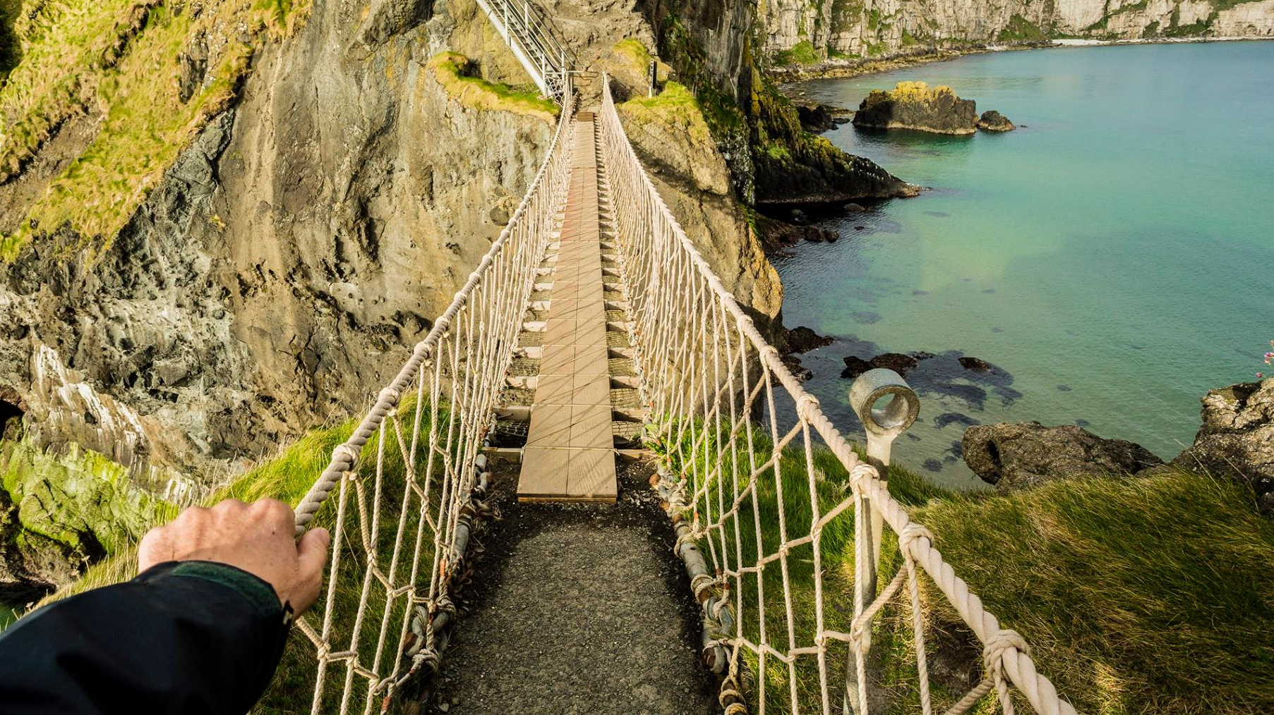

Slide 8
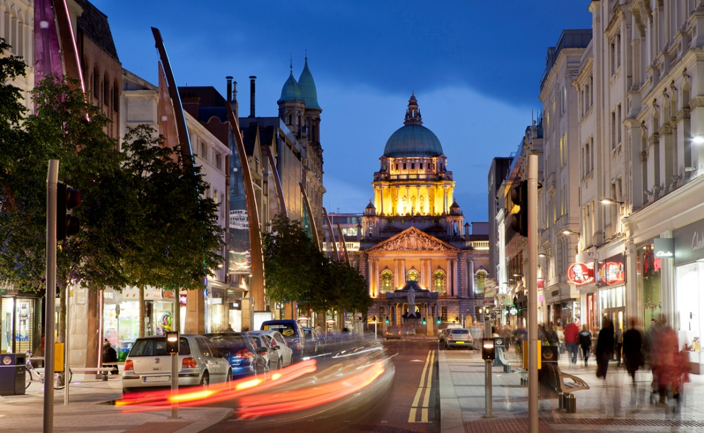

Slide 9
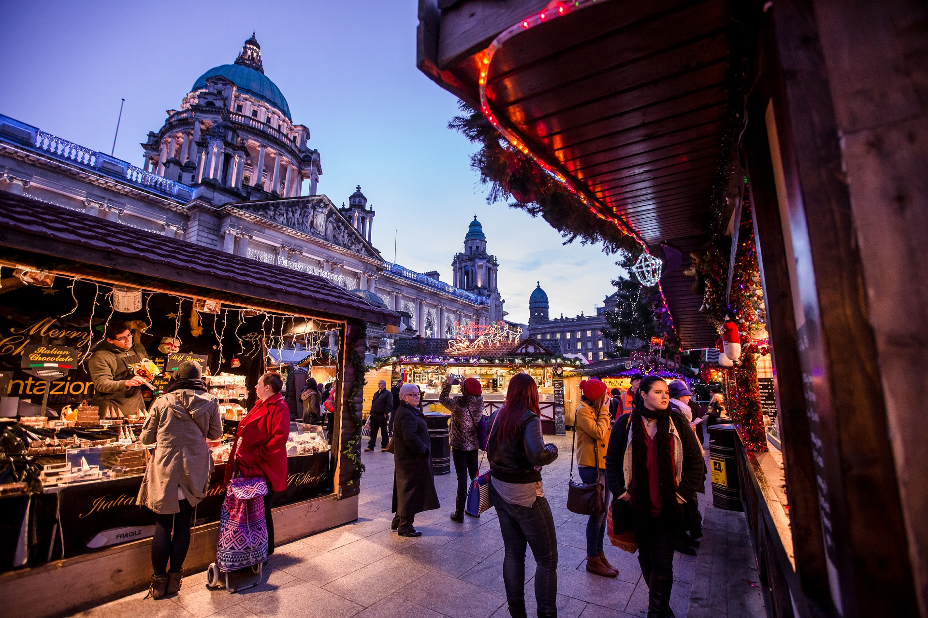

Slide 10
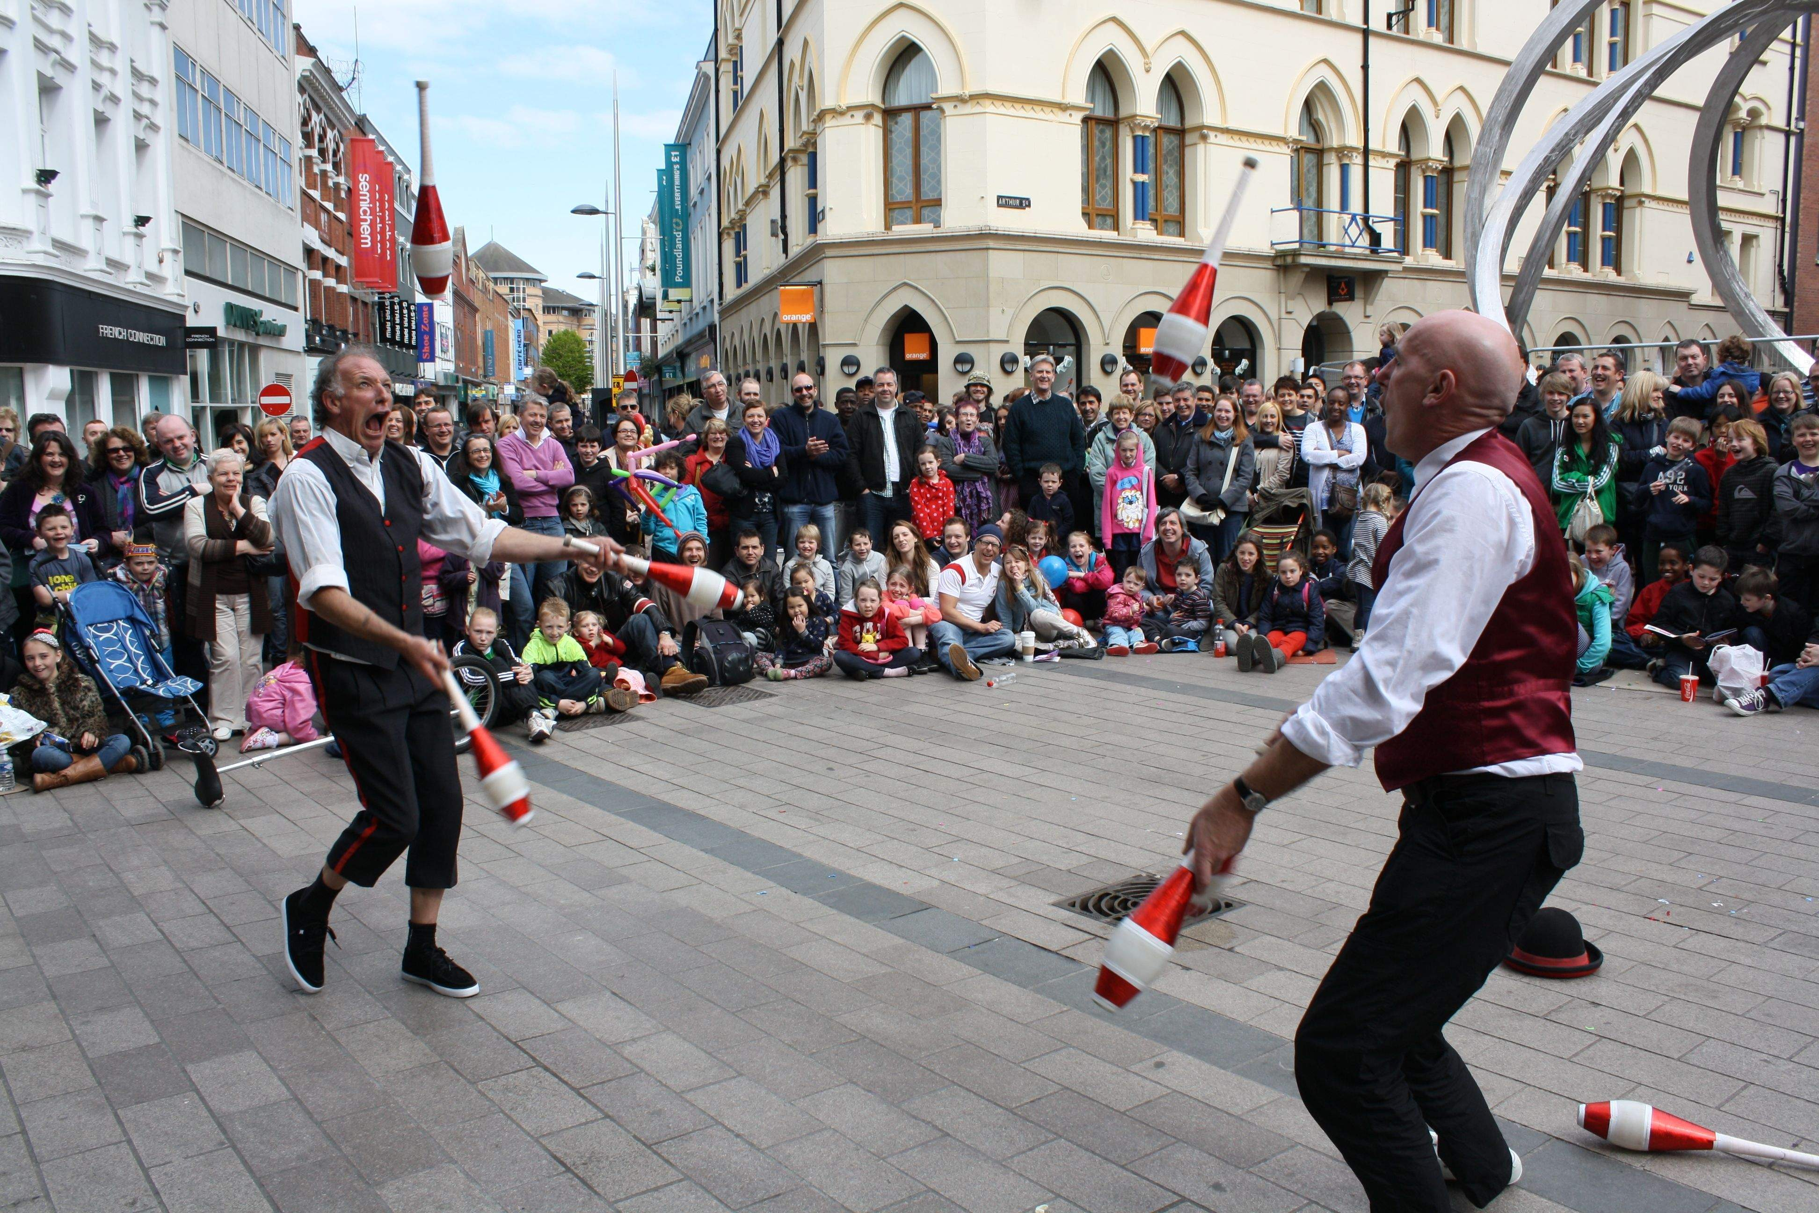

Slide 11
Living and Working here
Cost of Living
Northern Ireland is recognised by the British Council as having the lowest cost of living in the UK. The cost of living in Belfast will depend largely on your lifestyle. The currency in Belfast is the Great British Pound (sterling) (GBP), with one hundred pence (p) to each pound.
The cost of living in Belfast is significantly lower than in the UK capital, London. As well as much lower rents and property prices, the cost of transport, groceries and entertainment are all much lower in Belfast.
- Rented room in shared accommodation approx. £250 per month
- Rented 2 bedroom apartment in Belfast approx. £550 per month
- Rented 3 bedroom house in Belfast approx. £660 per month

Slide 12
Living and Working here
Market | Average |  | Drinks | Average
Apples (1kg) | £1.56 |  | Domestic Beer (0.5 litre draught) | £3.50
Chicken Breasts, (1kg) | £4.59 |  | Imported Beer (0.33 litre bottle) | £3.45
Eggs (12) | £1.89 |  | Wine (700ml, depending on brand) | £4.00
Lettuce (1 head) | £0.59 |  | Cappuccino | £1.60
Loaf of Fresh Bread | £0.89 |  | Coke/Pepsi (500ml bottle) | £1.20
Milk (2 litre) | £1.00 |  | Water (500ml bottle) | £1.00
Oranges (1kg) | £1.39 |  | Transport | Average
Potato (1kg) | £0.98 |  | One way ticket (in Belfast) | £1.35
Rice (1kg) | £1.22 |  | Monthly Pass | £35.00
Tomato (1kg) | £1.55 |  | Gasoline (1 litre) | £1.12
Restaurants | Average |  | Sports And Leisure | Average
Meal for 2 with 3 courses | £35.00 |  | Fitness Club, Monthly Fee for 1 Adult | £20.00
Meal for 1 at an inexpensive restaurant | £9.50 |  | Tennis Court Rent (1 Hour) | £6.50
Meal for 1 at a fast food restaurant | £5.00 |  | Cinema | £5.00

Slide 13
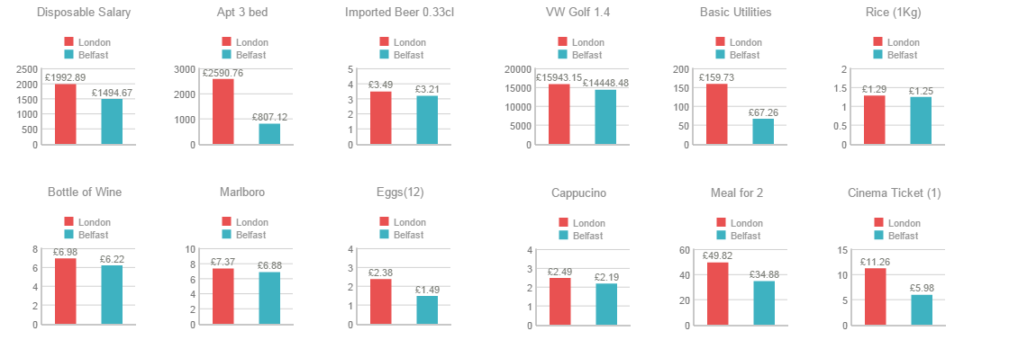
Living and Working here

Slide 14
Living and Working here
The Environment
In Belfast there are over 2,000 acres of parkland and nature reserves which include two city parks, nine district parks, 77 playgrounds, 36 local parks, five country parks and Belfast Zoo. A lot of the parks are home to buildings of huge cultural heritage such as Belfast Castle, Malone House and the Palm House, in Botanic Gardens.
Weather
Perched on the Atlantic coast of Europe, our air tends to be cleaner, our waters purer and our fields greener than elsewhere. Northern Ireland is lucky in being able to experience all the seasons. The mild and moist climate along with the coastal position of Northern Ireland means our winters are milder and summers are cooler than areas further east and south of Europe.
Safety
Crime in Northern Ireland remains low in comparison to other UK cities. Between 2003-04 and 2008-09, the crime rate in Belfast fell by around 15%. The increasing numbers of visitors coming to this vibrant city often comment on the absence of any evidence of unrest and on the warm and sincere welcome for which Belfast and Northern Ireland have always been renowned.

Slide 15
Living and Working here
What to see and do
You will find dramatic coastlines, castles, mountains, lakes, some of the best golf courses in the world, superb fishing, water sports, walking trails, scenic drives and historical landmarks. Northern Ireland also has many fine restaurants, cinemas, leisure centres and renowned theatres, galleries, arts and entertainment centres, and pubs and clubs.
Entertainment
Belfast boasts an array of entertainment venues including the Odyssey Arena, the Waterfront Hall and the Grand Opera House. Together they play host to international music artists, stand-up comedy, theatrical performances and musical stylings. Recent international artists who have played in Belfast include U2, Beyoncé, Lady Gaga and Katy Perry.
Sport and Leisure
Belfast is a sports fan’s ideal city with opportunities to attend football matches at Windsor Park, Gaelic games at Casement Park and rugby matches at Ravenhill. You can also check out Belfast’s biggest sporting sensation at the Odyssey Arena and cheer on the Belfast Giants ice hockey team.

Slide 16


Slide 17


Slide 18


Slide 19


Slide 20
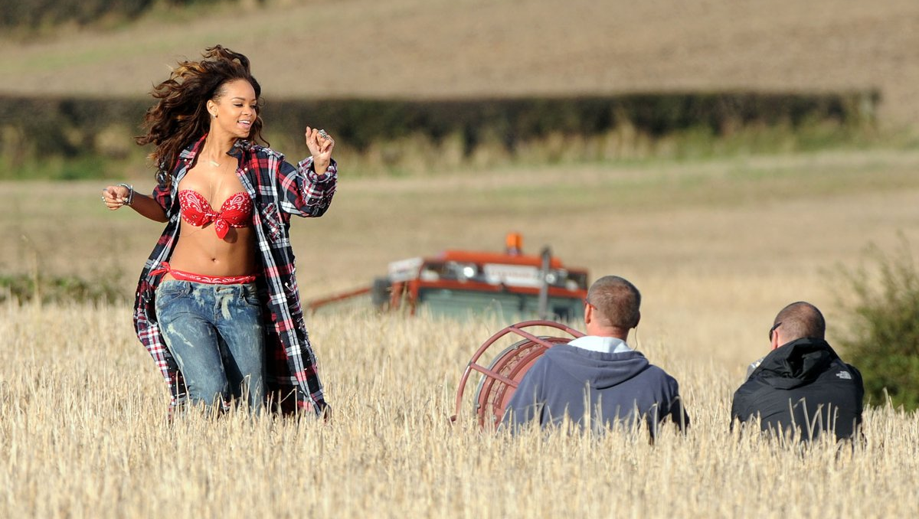

Slide 21
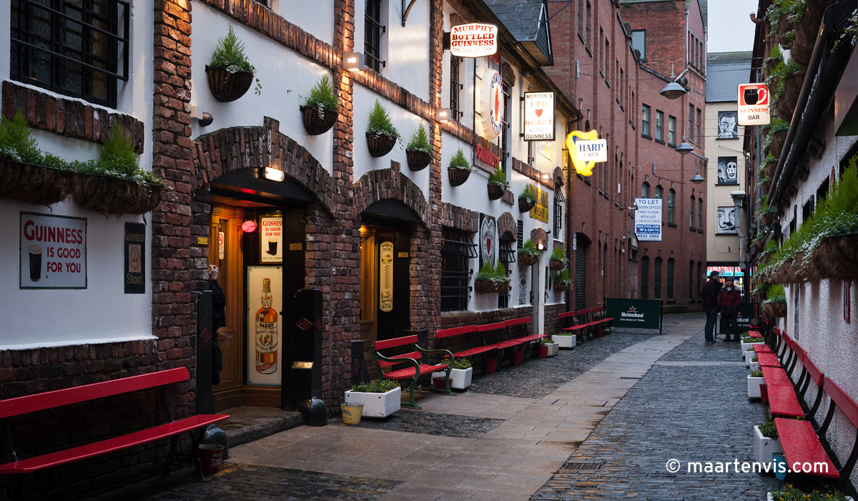

Slide 22
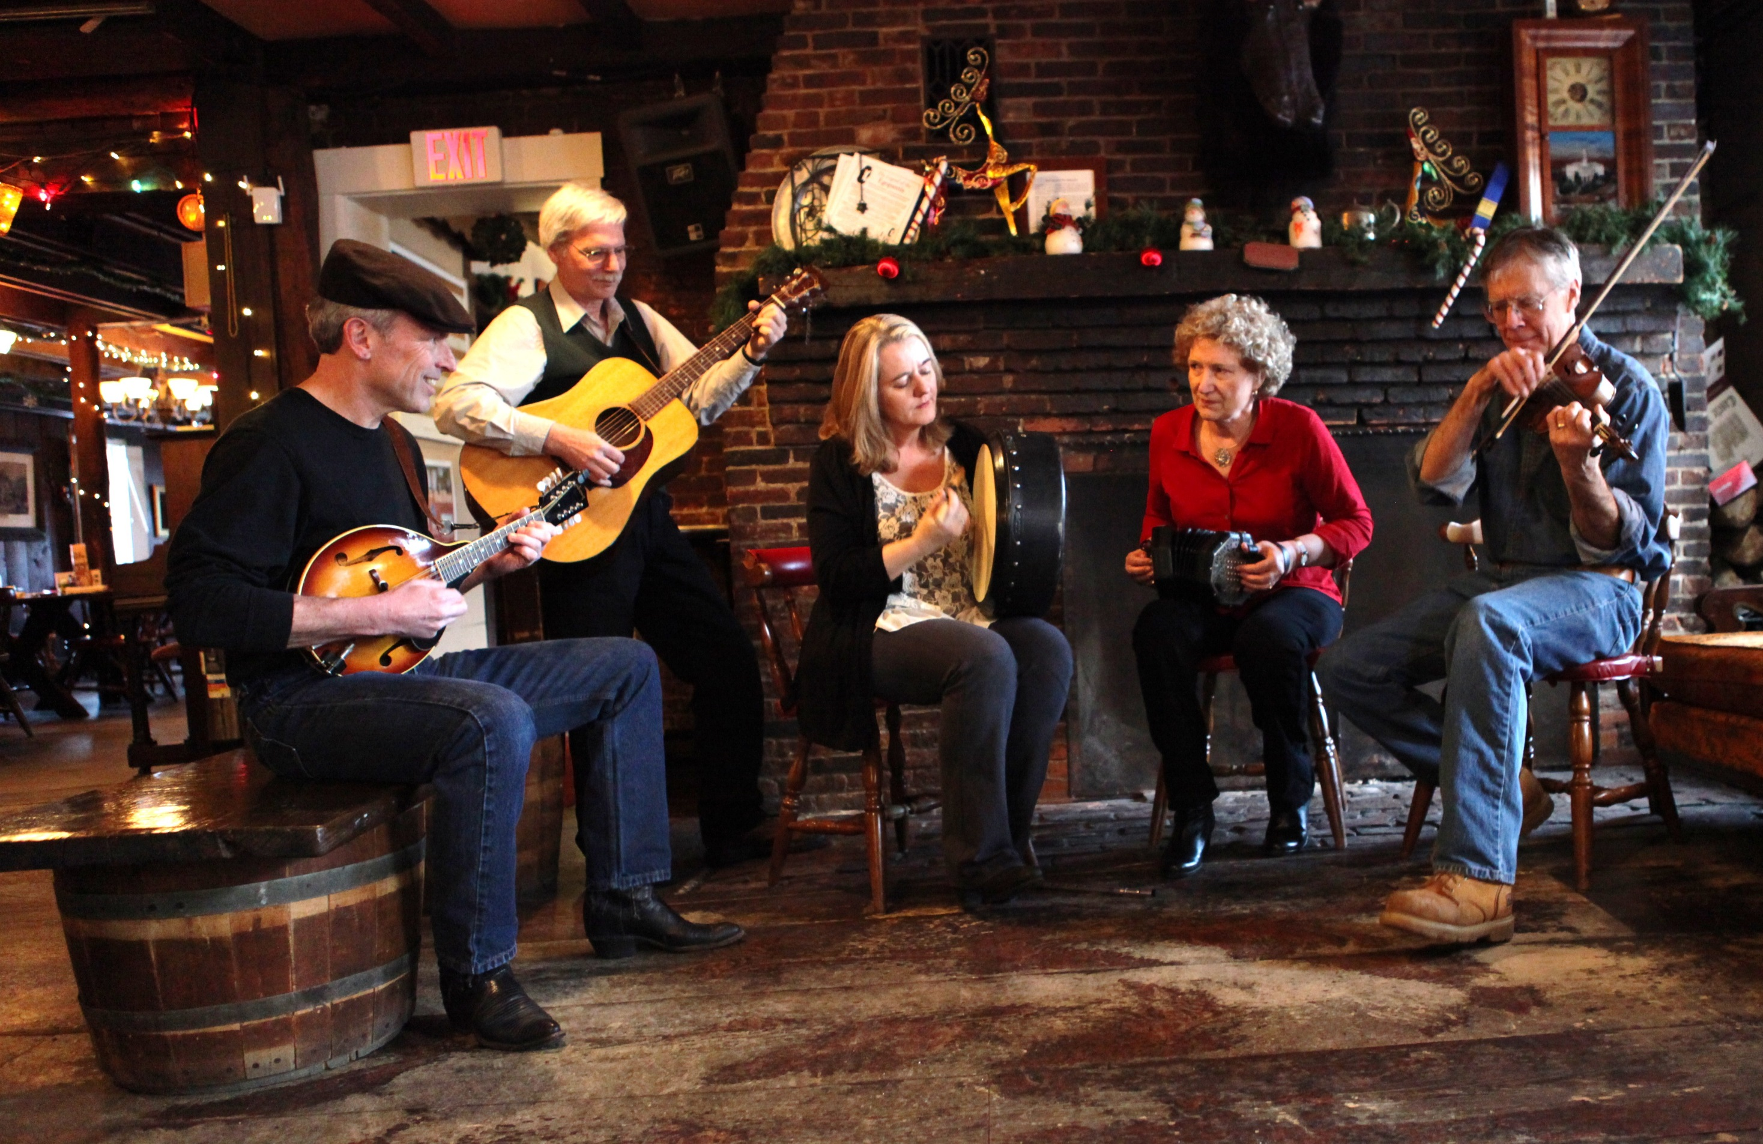

Slide 23


Slide 24


Slide 25
Living and Working here
Education
If you're considering adding to your own qualifications or thinking about raising a family, Belfast is the ideal city. With over 600 primary schools, 220 post primary schools Northern Ireland boasts the best academic performance in the UK and over 60% of school leavers go on to University or College.
According to a recent major survey, Northern Ireland is the best performing education system for primary maths in Europe, and the 6th best in the world. For primary reading it is the second best in Europe.
Two world class universities - University of Ulster and Queen’s University Belfast - and an extensive network of Further Education Colleges, provide vocational and academic training for those seeking to extend their skills.
Belfast is also highly regarded for its research and development accomplishments in multiple fields. We continue to lead the field in areas as diverse as pharmaceuticals, astrophysics, software development and aerospace

Slide 26
Living and Working here
Healthcare
The NHS provides free healthcare to all EU citizens.
Healthcare is provided through the National Health Service (NHS). Most NHS care is free, although items such as prescriptions and dental treatment must be paid for. EEA nationals may use NHS facilities in the same way as UK citizens, provided they have the correct E forms.
In order to claim this entitlement you will need to have a European Health Insurance Card. The European Health Insurance Card was introduced in 2006, to facilitate access to healthcare within the EU.
On arrival to Northern Ireland you should register with a local health centre where you will be assigned to a doctor. Your doctor can treat most illnesses but may refer you to a hospital if you require tests or your condition is more serious.
NHS hospitals provide free healthcare. If you are involved in an accident or suddenly take ill, you may need to go to Accident and Emergency (A&E). The number to call for an ambulance is 999 they will take you to the A&E at the nearest hospital.

Slide 27
Careers in IT
Employment of IT professionals within the IT industry in Northern Ireland is forecast to grow at 4% per annum – almost four times faster as the Northern Ireland average.
There are 29,000 people working in IT in Northern Ireland and jobs are multiplying four times faster than any other sector.
There is a requirement for 1,900 new IT Professionals every year.
Growth in the IT Professional workforce is forecast to be mainly amongst the more senior level/high value roles e.g. experienced Software Developers and Architects & System Designers.
25% of employers in Northern Ireland are aware of gaps in the skills of their IT workforce and 38% of employers seeking to recruit IT specialists had experienced difficulties filling these positions.
84% of employers affected thought that these skills gaps were having a negative effect on the running of their business and were most likely to cause an increase in workload for other staff and/or delays in the development of new products or services.

Slide 28
Careers in IT
We're looking for individuals with three years' plus experience in a broad range of fields to come and work with some of the world's leading blue chip companies, including Intel, Fujitsu, Citi Group and VISA, or at our fast growing Science Park.
With average salaries upwards of €40,000 across numerous IT job roles, we're confident you'll find the right opportunity in Northern Ireland to bring your career to the next level.
As an EU resident, you're free to work here without the need for a Visa.
Did you know ... Famous people born in Northern Ireland include singer Van Morrison, former Manchester United footballer George Best, Oscar nominated Kenneth Brannagh, the President of Ireland, Mary McAleese and Chronicles of Narnia author, CS Lewis.

Slide 29
















Careers in IT

Slide 30
Careers in IT
Job Role | Salary
.Net Developer | 25 000 – 42,000
Android Developer | 25,000 – 35,000
C / C++ Developer | 28,000 – 45,000
C# Developer | 25,000 – 45,000
Database Developer (Oracle / SQL Server / Sybase) | 30 000 – 45,000
Engineering / Development Manager | 45,000 – 65,000
iOS Developer | 25,000 – 35,000
Java Developer | 25,000 – 47,000
Oracle Applications Consultant (Technical / Functional) | 40000 – 50,000
Principal Developer / Technical Team Lead (J2EE / .NET) | 38,000 – 55,000
QA Automation Engineer | 23,000 – 38,000
QA Lead | 36,000 – 45,000
QA Manager | 40,000 – 55,000
Technical Writer | 25,000 – 35,000
UX Designer | 22,000 – 35,000
Web Developer | 20,000 – 35,000
Software developers have a great presence in Northern Ireland and the skillset for these candidates have become more demanding for large blue chip organisations and small software houses.
The opportunities for candidates in development are exciting, new and abundant. High demand skills within the software development sector include Java, C#, C++, SQL, Android and iOS.

Slide 31
Current Opportunities

Slide 32
Register your interest
There’s an excellent education system, a world-class healthcare service and all manner of very affordable property.
Northern Ireland may be renowned for its work ethic, but it places equal emphasis on the friendliness of the people and the quality of life. With little congestion, efficient public transport, and an easy-going lifestyle, there are few obstacles to generating a contented and productive workforce.
You can cross Northern Ireland by car in approx. two hours – north to south, or east to west – but in between there is a rich variety of scenery, activities, and a host of cultural attractions and leisure opportunities.
So there is always plenty to see and do – after work, of course!

